Slide 1

Probabilistic Safety Assessment of Aircraft Crew Oxygen Systems
B.Sc. Project – Reliability Analysis & Risk Assessment (Spring 2025)
Presenters: Hosein Asghari Hosouri & Ali Moradi
Instructor: Dr. Khodabakhsh
Date: September 5, 2025
Sharif University of Technology,
Department of Aeronautics and Astronautics

Slide 2
Presentation Roadmap
A structured approach to understanding aircraft oxygen system reliability.
01
02
Introduction & Motivation
Background & Literature
Setting the stage for our study.
Key concepts and previous research.
03
04
System Modeling & Reliability Prediction
Failure Criticality & Scenario Modeling
How we built and analyzed the system model.
Identifying critical failure points.
05
06
Risk Mitigation & Decision Analysis
FORM Analysis
Strategies for improving safety.
An optional, advanced reliability method.
07
08
Results & Discussion
Conclusion & Recommendations
Key findings and their implications.
Summary and future directions.

Slide 3
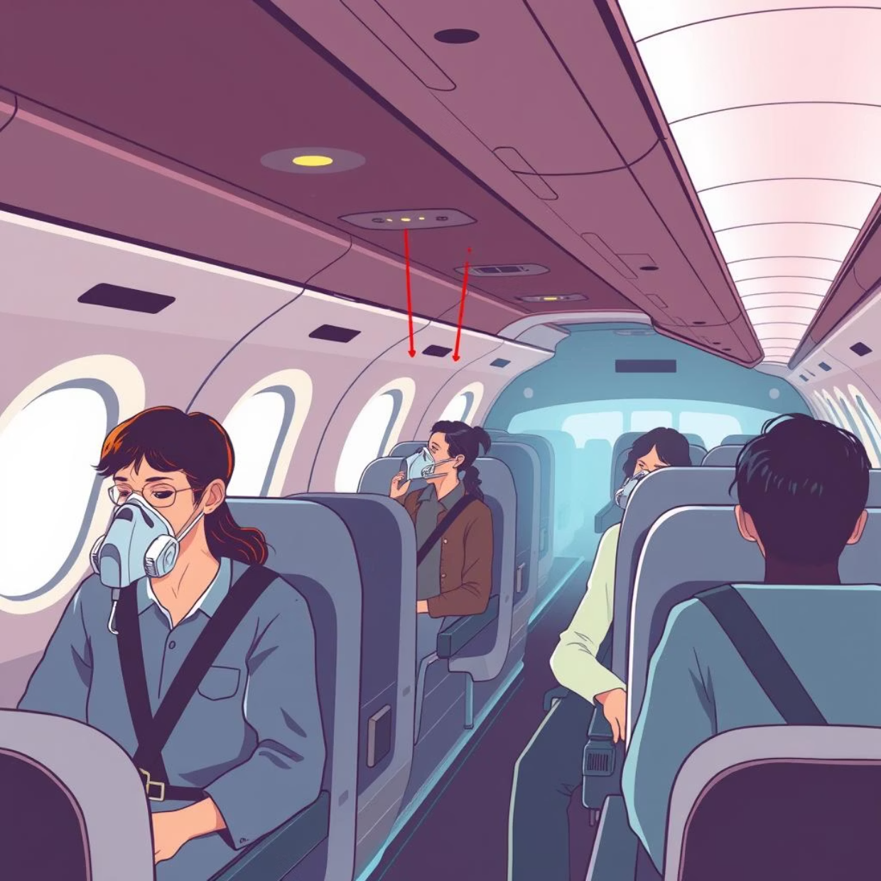

Introduction & Motivation: Ensuring Crew Safety
The crew oxygen system is paramount for pilot and crew survival during critical events like sudden cabin depressurization at high altitudes. Its reliability is non-negotiable.
A tragic example highlights this: Helios Airways Flight 522 (2005). A depressurization failure led to crew incapacitation, resulting in a devastating crash. This incident underscored the critical need for flawless oxygen system performance.
Our goal is to perform a Probabilistic Safety Assessment (PSA) for a Boeing 737-like oxygen system. We aim to ensure its failure probability is less than 10⁻⁹ per flight hour, as mandated by FAA Part 25.1309 for catastrophic failures.
The roadmap for our analysis involves various techniques:
Reliability Block Diagrams (RBD)
Failure Mode, Effects, and Criticality Analysis (FMECA)
Fault Tree Analysis (FTA)
Monte Carlo Simulation
Decision Analysis
First Order Reliability Method (FORM)
Ethical Note: As engineers, we bear the profound responsibility to prevent oversights that could lead to human casualties and significant financial losses.

Slide 4

Foundational Concepts & Literature Review
Understanding the framework for aerospace safety.
Reliability Defined
RBD
Visualizes system components and their functional relationships.
The probability that a system will perform its intended function without failure for a specified period under given conditions.
FMECA
Identifies potential failure modes and their effects.
FTA
Top-down, deductive failure analysis.
Regulatory Mandates
Monte Carlo
Simulates outcomes based on random sampling.
FAA AC 25.1309 and MIL-STD-882E dictate failure probabilities below 10⁻⁹ for catastrophic events.
Decision Analysis
Structured approach to evaluate choices under uncertainty.
Reliability data was sourced from industry standards like OREDA and MIL. We categorized the oxygen system into three key components:
Storage & Control: Cylinders, valves, regulators.
Distribution & Delivery: Tubing, masks, deployment mechanisms.
User Detection & Usage: Pressure sensors, mask activation.

Slide 5
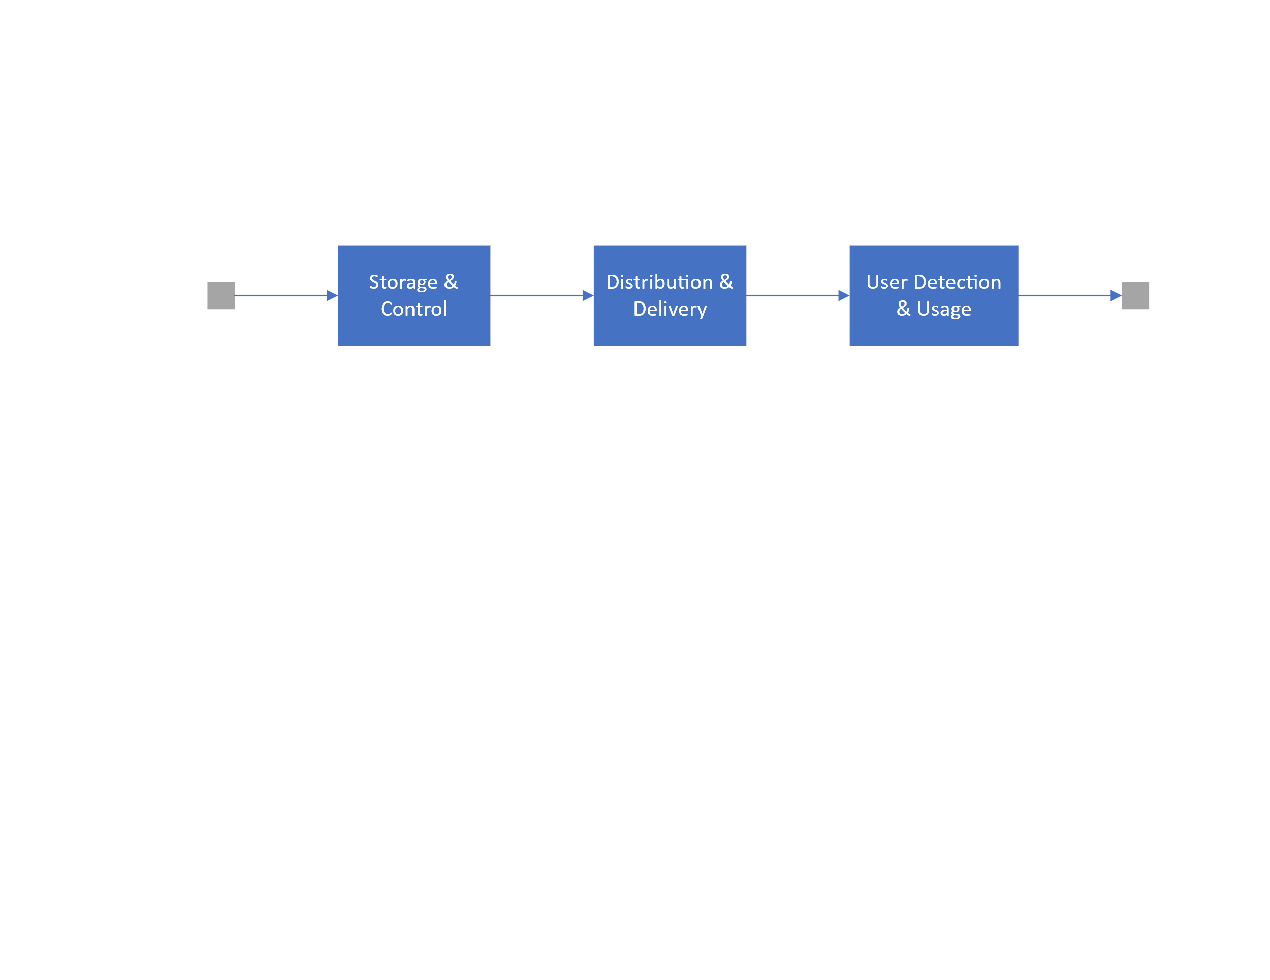
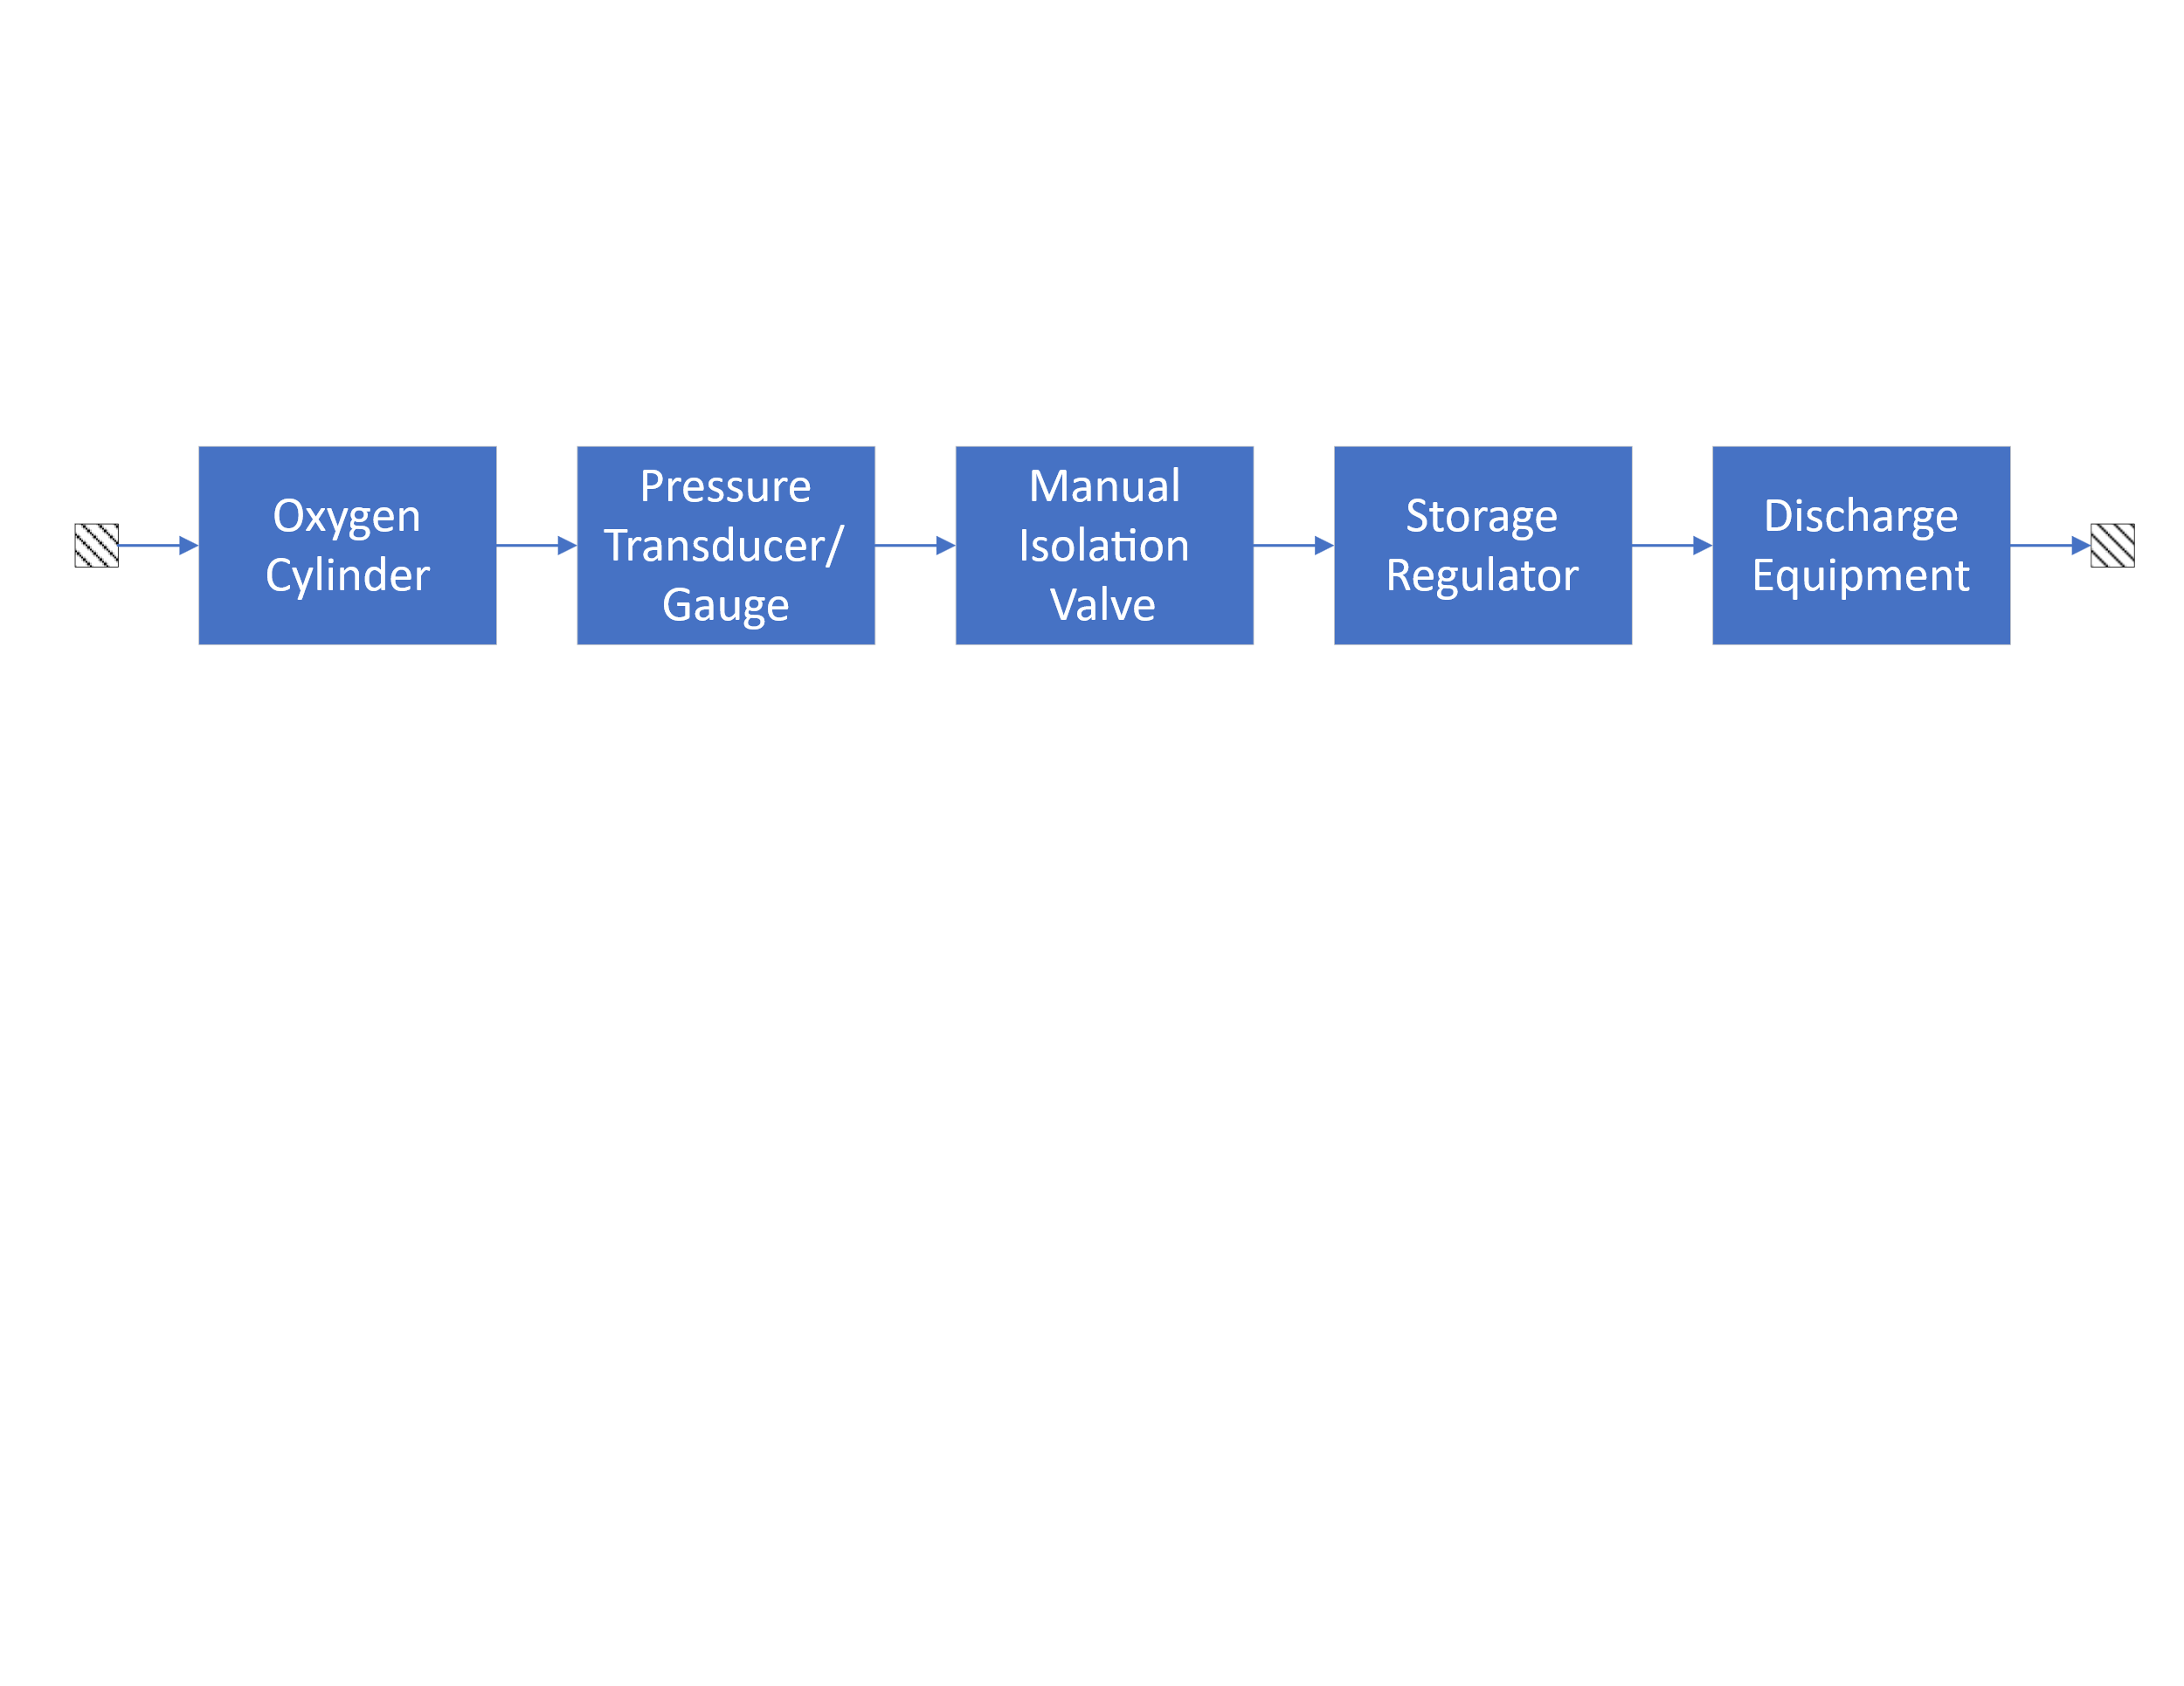
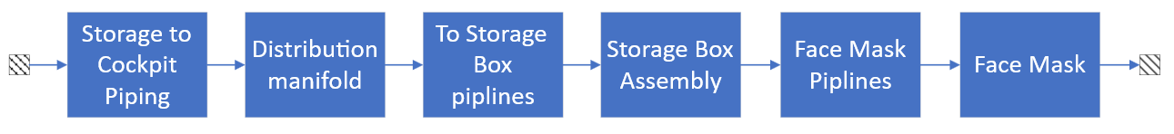
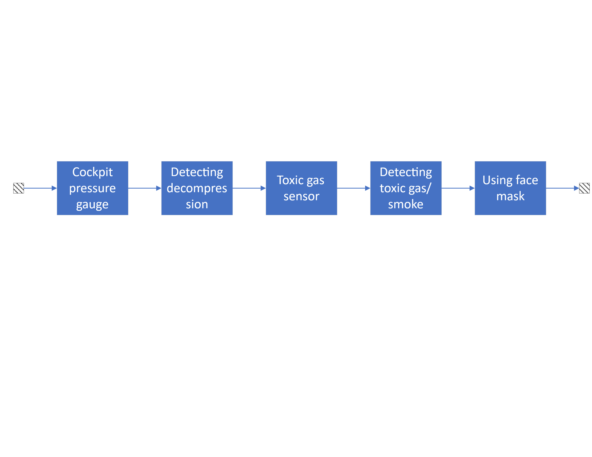
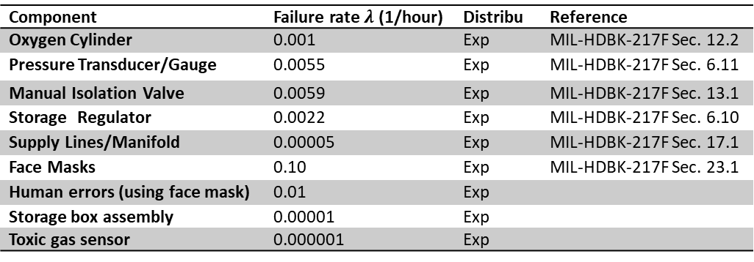
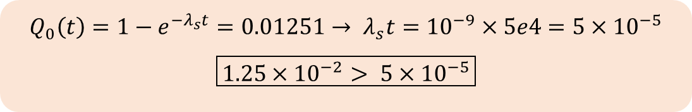
System Modeling & Reliability Prediction
System’s RBD
Deconstructing the oxygen system into its operational components.
RBD Structure
Storage & Control RBD
1
We developed a Reliability Block Diagram (RBD) categorizing the system into three main subsystems: Storage & Control, Distribution & Delivery, and User Detection & Usage.
Failure Rate Data
2
Component failure rates were derived from an Excel file, utilizing both Exponential and Weibull distributions as appropriate.
Distribution & Delivery RBD
3
Reliability Calculation
Our calculations indicated a failure probability of approximately 5e-5 over 50,000 flight hours.
User Usage & Detection RBD
Critical Finding
4
This baseline failure probability significantly exceeds the FAA's strict 10⁻⁹ threshold, highlighting an urgent need for improvements.
Component | Failure rate $λ$ (1/hour) | Distribu | Reference
Oxygen Cylinder | 0.001 | Exp | MIL-HDBK-217F Sec. 12.2
Pressure Transducer/Gauge | 0.0055 | Exp | MIL-HDBK-217F Sec. 6.11
Manual Isolation Valve | 0.0059 | Exp | MIL-HDBK-217F Sec. 13.1
Storage Regulator | 0.0022 | Exp | MIL-HDBK-217F Sec. 6.10
Supply Lines/Manifold | 0.00005 | Exp | MIL-HDBK-217F Sec. 17.1
Face Masks | 0.10 | Exp | MIL-HDBK-217F Sec. 23.1
Human errors (using face mask) | 0.01 | Exp
Storage box assembly | 0.00001 | Exp
Toxic gas sensor | 0.000001 | Exp
$$Q_{0}\left(t\right)=1−e^{−λ_{s}t}=0.01251→ λ_{s}t={10}^{−9}×5e4=5×{10}^{−5}$$
$$\boxed{1.25×{10}^{−2}> 5×{10}^{−5}}$$
The initial assessment reveals a substantial gap between current reliability and regulatory requirements.

Slide 6
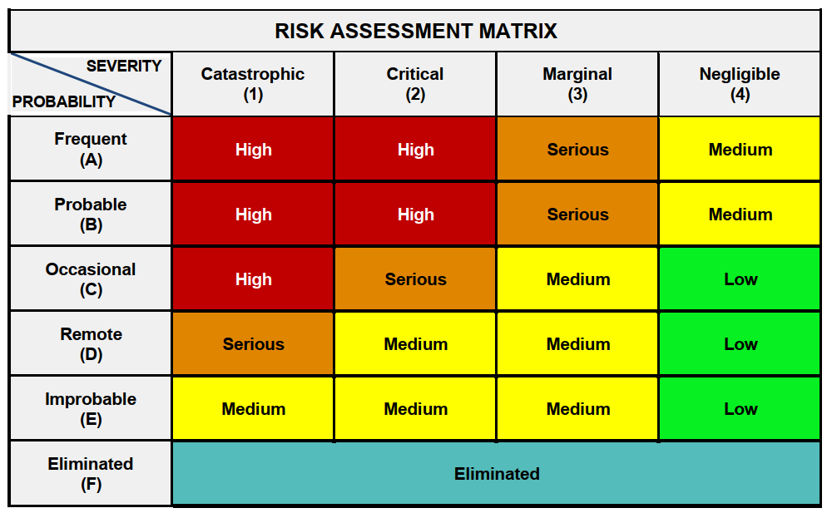
Failure Criticality & Scenario Modeling
Component | Failure Mode | Causes | Effects | Severity | Probability | Risk | Mitigation Measures
Oxygen Cylinder | Pressure leak or explosion | Corrosion, mechanical damage, overpressure | Oxygen depletion, crew hypoxia, fire risk | 1 (Catastrophic) | C (Occasional) | High | Periodic inspections, use of resistant materials, backup system
Pressure Regulator | Improper pressure regulation (high/low) | Mechanical failure, clogging | Insufficient or excessive oxygen, mask damage | 2 (Critical) | B (Probable) | High | Redundant design, input filters, automatic monitoring
Oxygen Masks | Failure in oxygen delivery (leak or blockage) | Physical damage, wear | Immediate crew hypoxia, loss of aircraft control | 1 (Catastrophic) | C (Occasional) | High | Quick-donning masks, pre-flight testing
Pressure Transducer | Incorrect pressure reading | Electronic failure, miscalibration | Undetected leak, delayed response | 2 (Critical) | D (Remote) | Serious | Redundant sensors, automatic alerts
Tubing/Lines | Leak or crack | Corrosion, vibration, weak connections | System pressure loss, contamination | 2 (Critical) | B (Probable) | High | Stainless steel usage, flareless fittings, visual inspections
Delving deeper into potential failure points and their impact.
FMECA Insights
Our Failure Mode, Effects, and Criticality Analysis (FMECA) identified crew oxygen masks as components with a high-Risk Priority Number (RPN). Their failure could directly lead to incapacitation.
Fault Tree Analysis (FTA)
The FTA, with "Insufficient Oxygen Delivery" as the top event, uncovered 16 minimal cut sets. These represent the simplest combinations of component failures that could lead to the system's failure.
Monte Carlo Simulation
Running 10,000 trials, the Monte Carlo simulation confirmed a failure probability (Pf) of approximately 1.25e-2, consistent with our initial RBD calculations.
The limit state function g(X) was defined as the product of individual component reliabilities, allowing us to quantify the overall system performance boundary.
MIL-STD-882E Risk assessment matrix

Slide 7
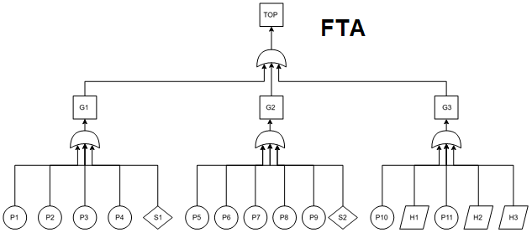
Failure Criticality & Scenario Modeling
Delving deeper into potential failure points and their impact.
FMECA Insights
Our Failure Mode, Effects, and Criticality Analysis (FMECA) identified crew oxygen masks as components with a high-Risk Priority Number (RPN). Their failure could directly lead to incapacitation.
Fault Tree Analysis (FTA)
The FTA, with "Insufficient Oxygen Delivery" as the top event, uncovered 16 minimal cut sets. These represent the simplest combinations of component failures that could lead to the system's failure.
No | ID | Description
1 | TOP | Insufficient oxygen delivery during decompression
2 | G1 | Leaks and pressure problems in the tank
3 | G2 | Leaks in transmission lines
4 | G3 | Inability of the crew to recognize and use the oxygen system
5 | P1 | Gas leak or burst oxygen cylinder
6 | P2 | Gas leak in the pressure gauge or failure to measure pressure
7 | P3 | Gas not passing through the manual valve
8 | P4 | Failure to adjust the gas pressure output from the tank
9 | P5 | Gas not reaching the cockpit
10 | P6 | Lack of/improper distribution of gas
11 | P7 | Gas not reaching from the distribution plate to the storage box
12 | P8 | Leakage in storage box
13 | P9 | No gas flow in the mask hose
14 | P10 | Error in cockpit oxygen pressure report
15 | P11 | Error in cockpit toxic gas/smoke report
16 | S1 | Failure to relieve excess pressure from the tank and pipes
17 | S2 | Oxygen mask failure
18 | H1 | Pilot's failure to understand oxygen pressure drop
19 | H2 | Pilot's failure to understand toxic gas/smoking
20 | H3 | Incorrect use of masks
Monte Carlo Simulation
Running 10,000 trials, the Monte Carlo simulation confirmed a failure probability (Pf) of approximately 1.25e-2, consistent with our initial RBD calculations.
The limit state function g(X) was defined as the product of individual component reliabilities, allowing us to quantify the overall system performance boundary.

Slide 8


Conclusion & Recommendations
Securing the skies through continuous improvement.
The crew oxygen system, with strategic upgrades, successfully meets the stringent FAA safety objectives of less than 10⁻⁹ failure probability.
Key improvements include implementing 240-hour inspection intervals and enhancing mask system redundancy.
This proactive approach, exemplified by early intervention, is vital in preventing accidents similar to Helios Flight 522.
Future Work
Integrate more extensive field data for refined models.
Conduct real-world testing to validate simulations.
Develop advanced human factors modeling for crew interaction.
References: OREDA (Offshore Reliability Data Handbook), FAA AC 25.1309 (System Safety Assessment), MIL-STD-882E (System Safety Program Requirements). Full details available in the project report folders.
Thank you! Questions?

